Slide 1

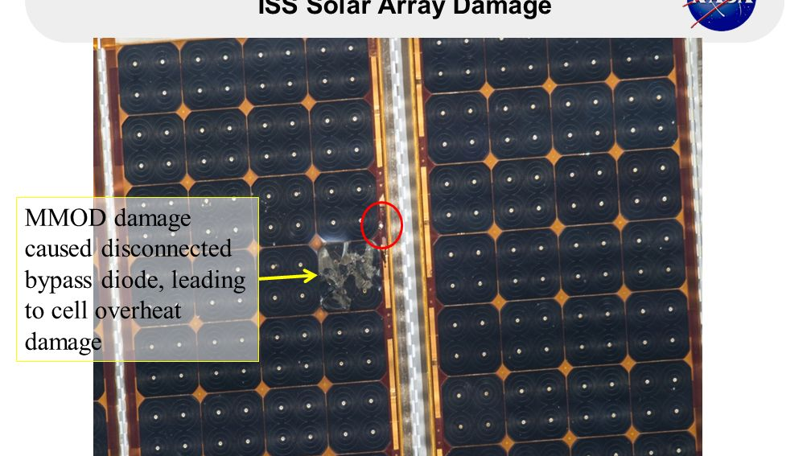
SPACE DEBRIS
PART 2

Slide 2
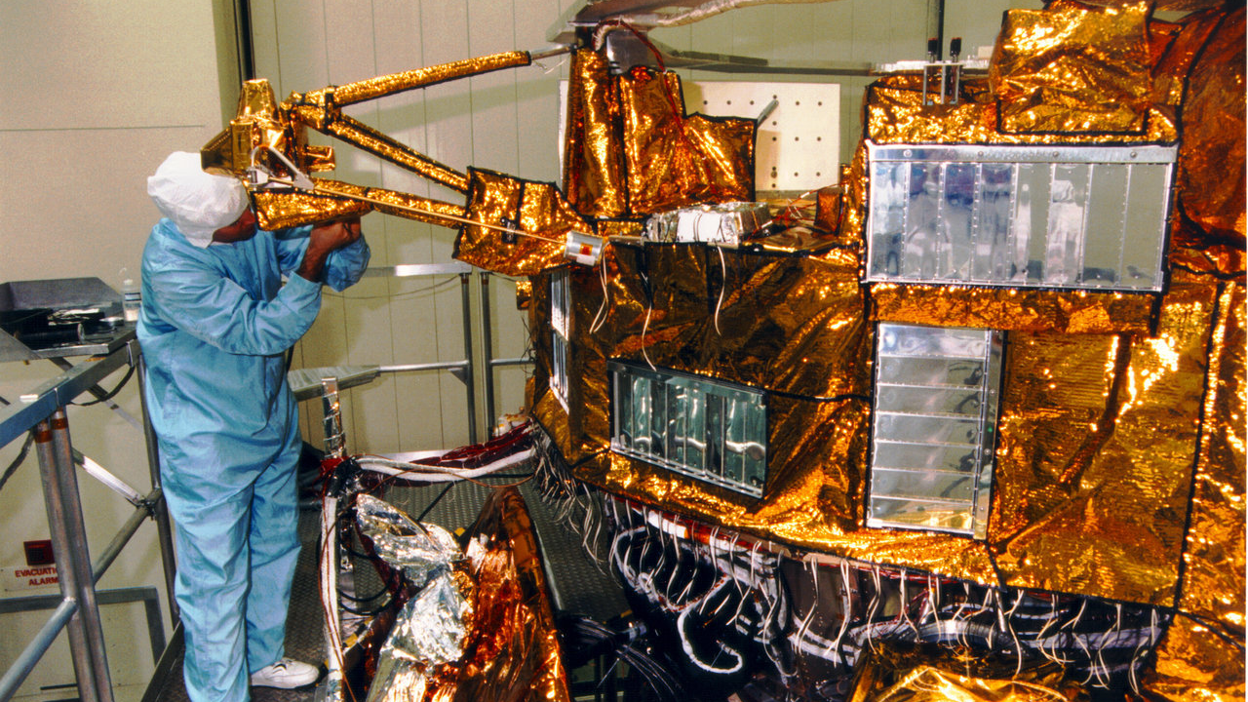
THERMAL BLANKETS

Slide 3
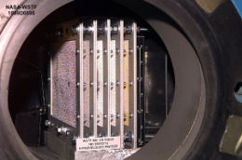
Other solutions - operational
Point sensitive surfaces away from RAM
Fly at altitudes/inclinations where debris is minimized
Use leading edge “bumper”

Slide 4
Other solutions - preventative
Avoid single stage-to-orbit boosters
Use longer life satellites
Vent fuel tanks at the end of a mission
Move inactive satellites
You move out of the paths of large debris

Slide 5
7. Describe three of the technology solutions to help reduce the harmful effects of space debris. Explain how it might be implemented and provide one example.

Slide 6
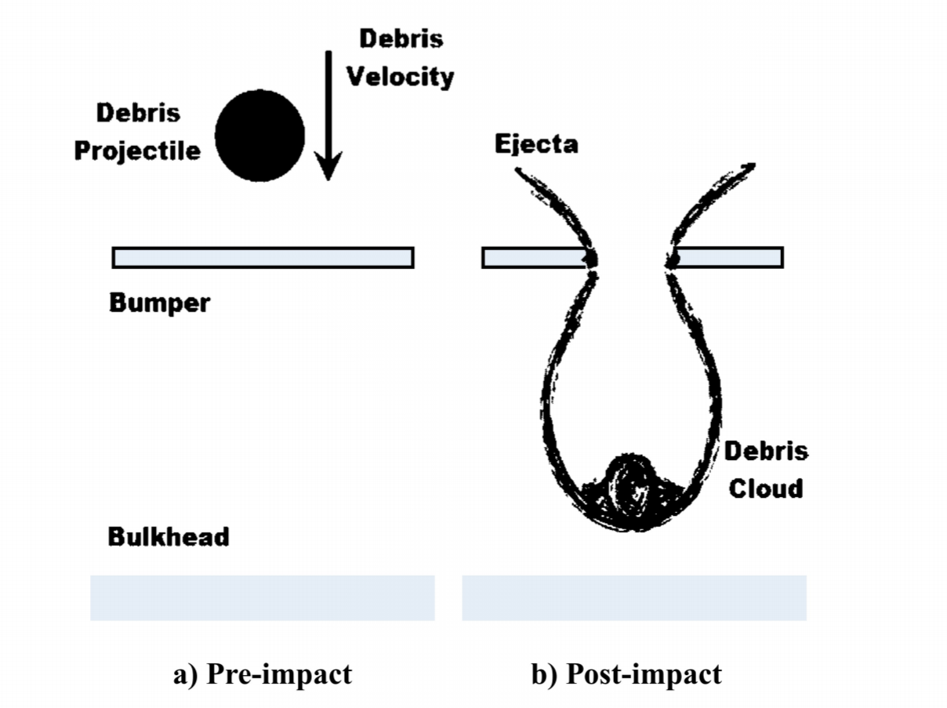
WHIPPLE SHIELDS

Slide 7
WHIPPLE DESIGN – BUMPER THICKNESS

Slide 8
WHIPPLE DESIGN – WALL THICKNESS

Slide 9
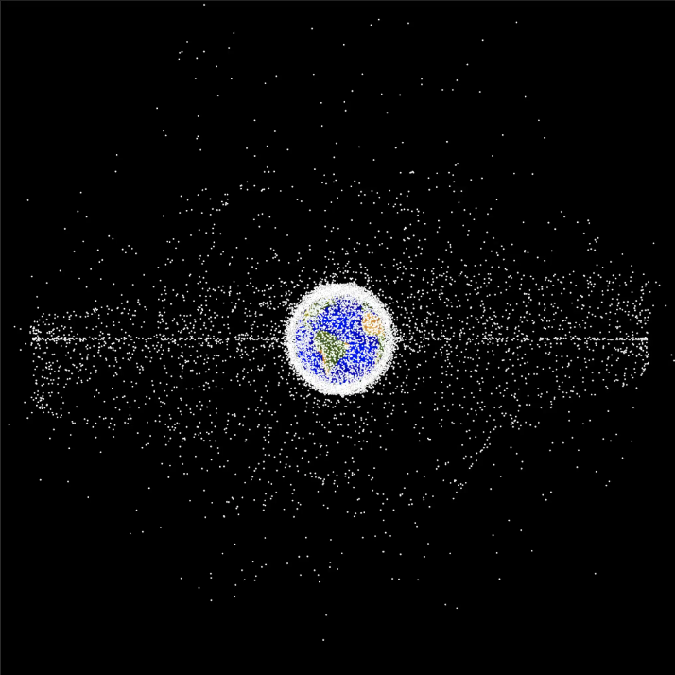
Space Debris Mitigation Guidelines of the UN Committee on the Peaceful Uses of Outer Space

Slide 10
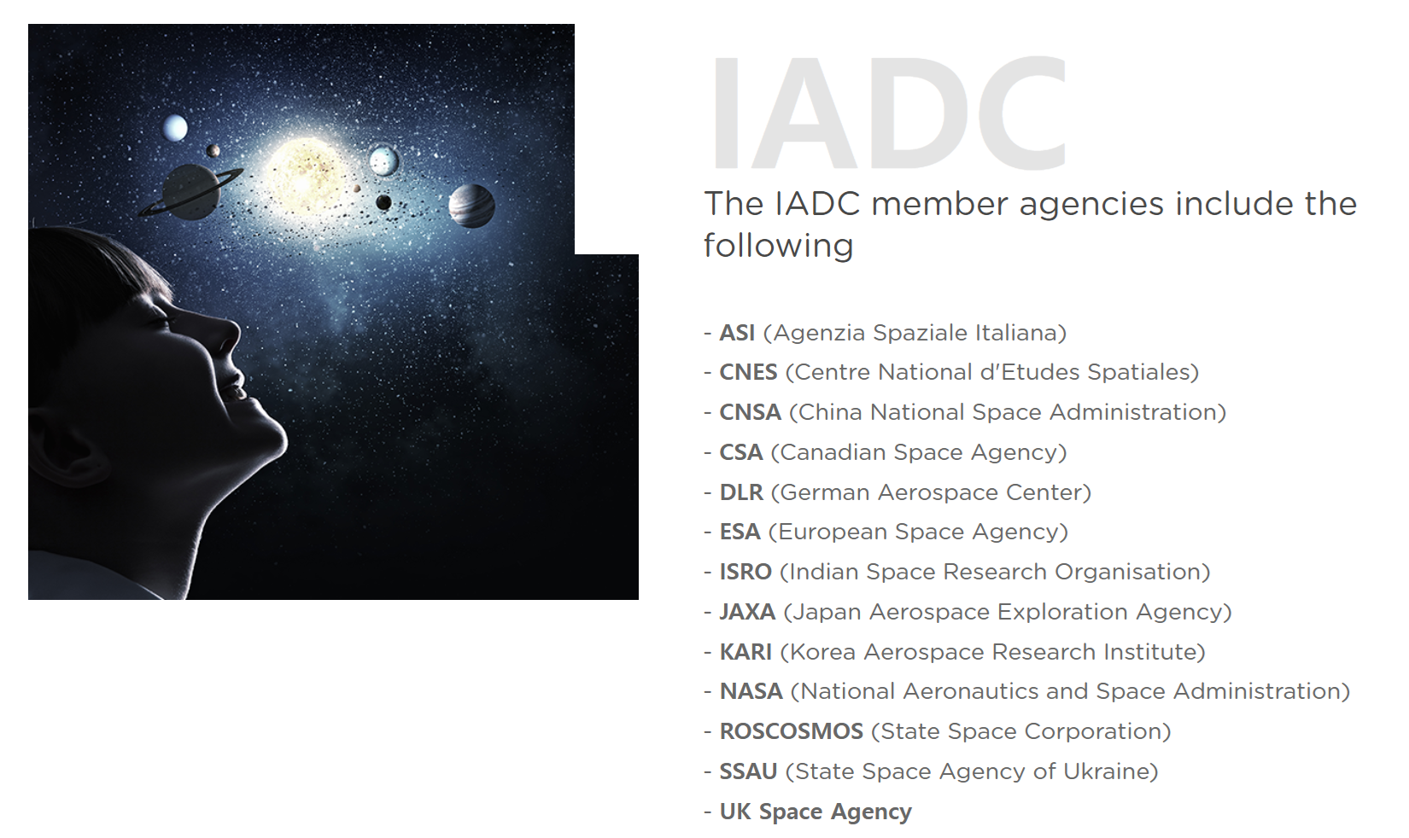

Slide 11
Explain the guideline how might it be implemented? has it been violated?
What are the UN guidelines?
Debris release during normal operations.
Minimize the potential for breakups during operational phases
Limit the probability of accidental collision in orbit.
Avoid intentional destruction and other harmful activities
Minimize potential for post-mission breakups resulting from stored energy
Limit the long-term presence of spacecraft and launch vehicle orbital states in the low earth orbit region after the end of their mission.
Limit the long-term interference of spacecraft and launch vehicle orbital stages with the geosynchronous Earth orbit region after the end of their mission.

Slide 12
DEBRIS MITIGATION – UN GUIDELINES
Limit debris release during normal operations.
“Space Systems should be designed not to release debris during normal operations. If this is not feasible, the effect of any release of debris on the outer space environment should be minimized.”

Slide 13
DEBRIS MITIGATION – UN GUIDELINES
2) Minimize the potential for breakups during operational phases.
“Spacecraft and launch vehicle orbital stages should be designed to avoid failure modes which may lead to accidental break-ups. In cases where a condition leading to such a failure is detected, disposal and passivation measures should be planned and executed to avoid break-ups.”

Slide 14
DEBRIS MITIGATION – UN GUIDELINES
3) Limit the probability of accidental collision in orbit.
“In developing the design and mission profile of spacecraft and launch vehicle stages, the probability of accidental collision with known objects during the system’s launch phase and orbital lifetime should be estimated and limited. If available orbital data indicate a potential collision, adjustment of the launch time or an on-orbit avoidance maneuver should be considered.”

Slide 15
DEBRIS MITIGATION – UN GUIDELINES
4) Avoid intentional destruction and other harmful activities
“Recognizing that an increased risk of collision could pose a threat to space operations, the intentional destruction of any on-orbit spacecraft and launch vehicle orbital stages or other harmful activities that generate long-lived debris should be avoided. When intentional break-ups are necessary, they should be conducted at sufficiently low altitudes to limit the orbital lifetime of resulting fragments.”

Slide 16
DEBRIS MITIGATION – UN GUIDELINES
5) Minimize potential for post-mission breakups resulting from stored energy
“In order the limit the risk to other spacecraft and launch vehicle orbital stages from accidental break-ups, all on-board sources of stored energy should be depleted or made safe when they are no longer required for mission operations or post-mission disposal.”

Slide 17
DEBRIS MITIGATION – UN GUIDELINES
6) Limit the long-term presence of spacecraft and launch vehicle orbital states in the low earth orbit region after the end of their mission.
“Spacecraft and launch vehicle orbital states that have terminated their operational phases in orbits that pass through the LEO region should be removed from orbit in a controlled fashion. If this is not possible, they should be disposed of in orbits that avoid their long-term presence in the LEO region.”

Slide 18
DEBRIS MITIGATION – UN GUIDELINES
7) Limit the long-term interference of spacecraft and launch vehicle orbital stages with the geosynchronous Earth orbit region after the end of their mission.
“Spacecraft and launch vehicle orbital stages that have terminated their operational phases in orbits that pass through the GEO region should be left in orbits that avoid their long-term interference with the GEO region.

Slide 19
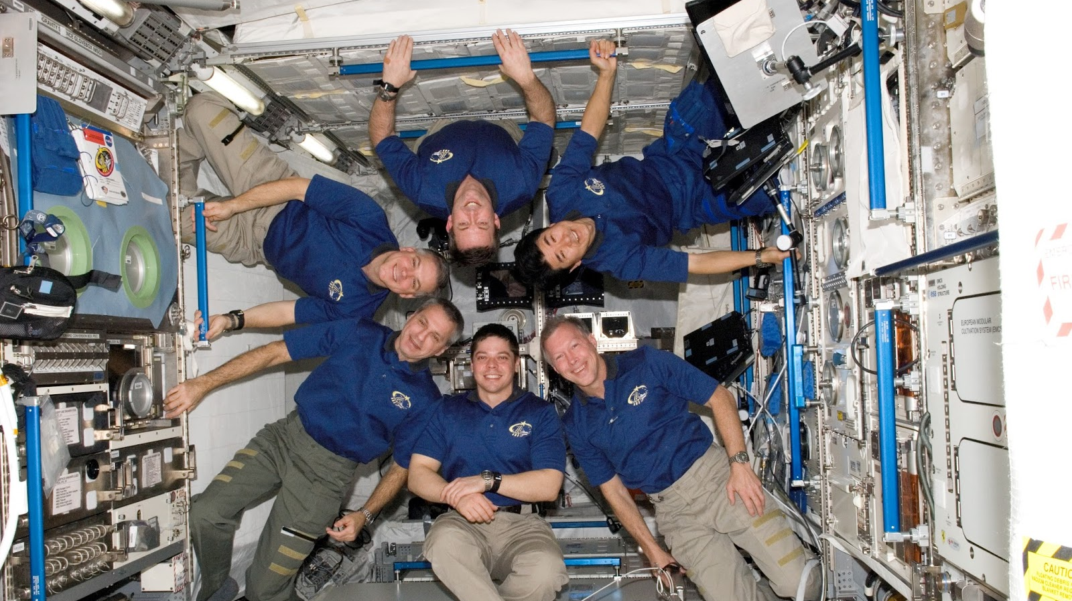
Next
The Vacuum Environment

